Slide 1
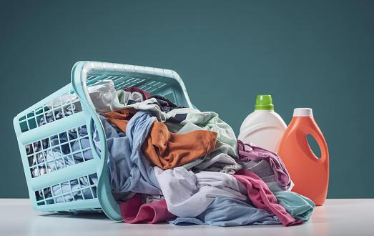
DBMS PROJECT
LaundroFresh

Slide 2

TEAM MEMBERS
Adithyaraj K - 125003013
Vishnu B - 125003473

Slide 3

Objective
In this project, we aim to develop a database management system for laundry services in hostel and calculate the monthly fee to be paid based on the number of times the service is requested.

Slide 4

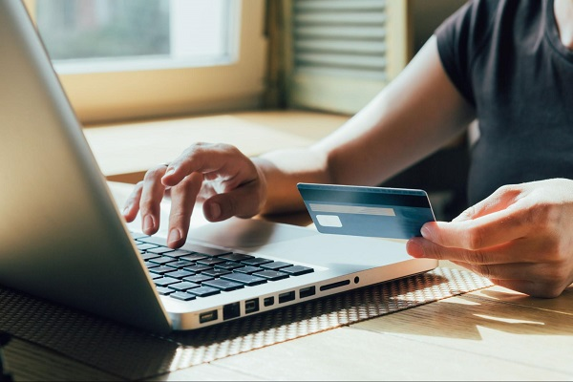
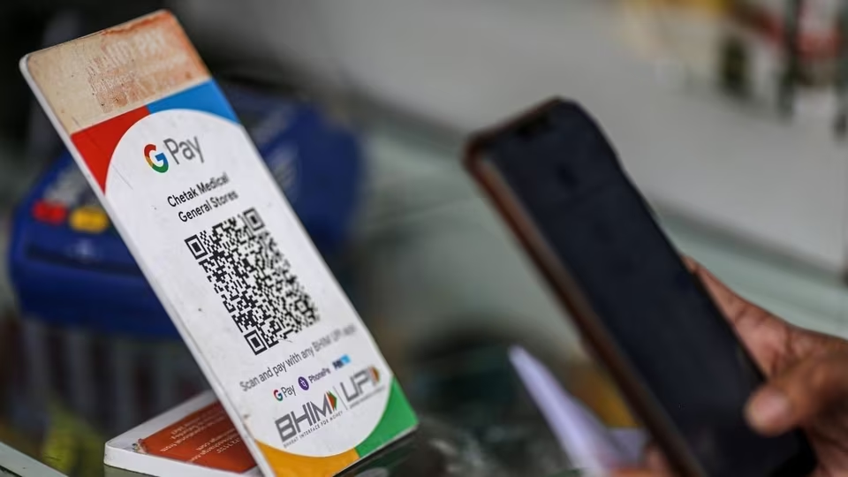
Why this project?
Students find it difficult to make time to wash clothes especially during exam times.
It is generally required to pay every time the service is availed.The UPI payments used sometimes tends to fail due to unstable network.
Students may sometimes have insufficient funds and need to borrow or keep accounts with the provider.

Slide 5

Solutions offered by this project
This project emphasizes monthly payment using online banking alongside with UPI,which is more convenient to both the service provider and the students.
This also solves the problem of failed payments since the rate of failure in online banking is lower compared to UPI payments,in case it fails.
Monthly basis of payments means that students can manage their finances better.

Slide 6





Interface Model
HTML
Users can query and update the database through an interactive webpage.
Frontend- Web Page development with HTML,CSS and JavaScript.
Backend-Database creation and management using MySQL.
CSS
JavaScript
MySQL

Slide 7
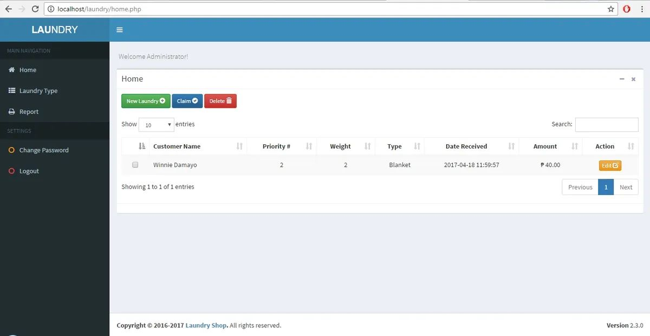
Model Web Page
*for representation purposes only.
*picture does not refer to actual interface

Slide 8
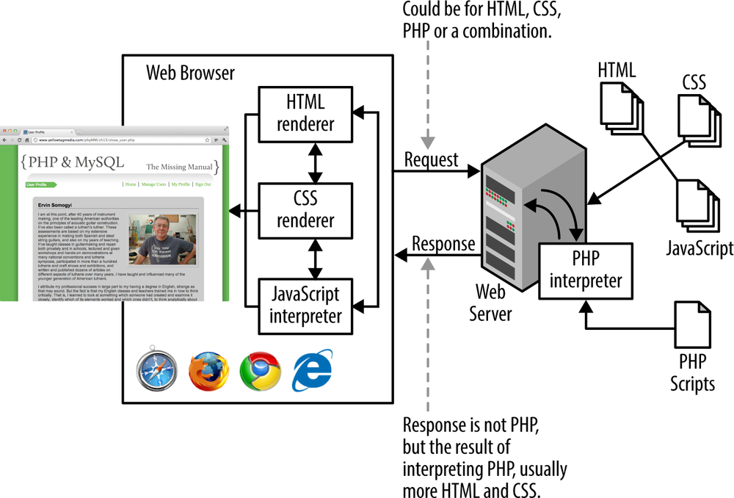
Connecting Web Page to Database
MySQL

Slide 9
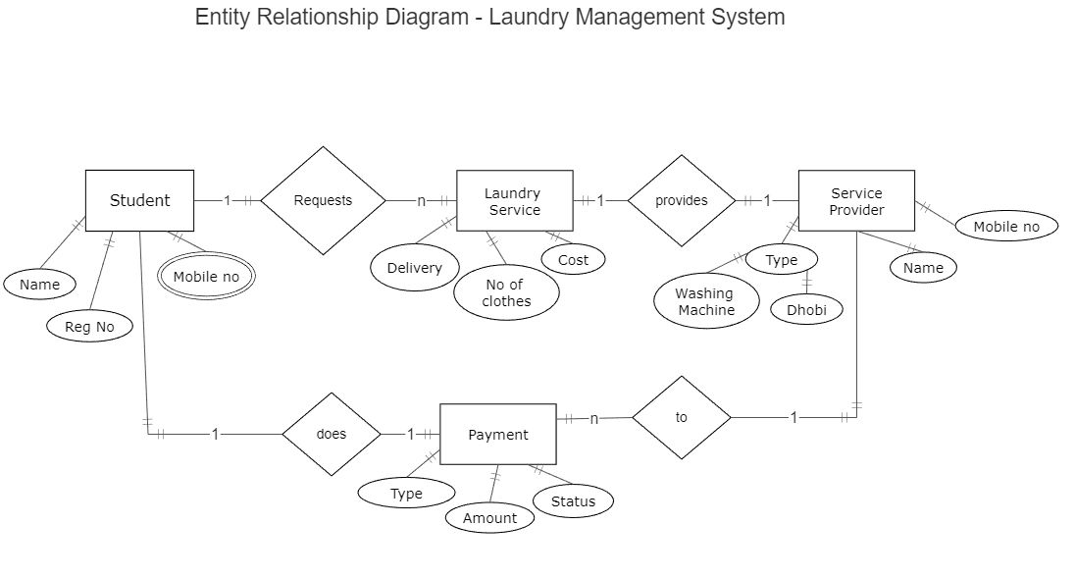

Slide 10


